Slide 1
SQUID PROXY/ CACHING SERVERs
By
PRUDHVI REDDY ARAGA

Slide 2

INTRODUCTION – LINUX
High-level Operating system based on UNIX
Free and Open Source License
Linux was created in 1991 by Linus Torvalds
Linux includes Kernel, System User Space and Applications
Red Hat is leading Contributor of Linux

Slide 3

INTRODUCTION- CenTOS
Community Enterprise Operating System
Originally Called, CAOS Linux
CENTOS Version 8
RHEL Development Kernel
Software Collections
CENTOS Repositories
Notes:
CENTOS – Stands for Community EnterPrise Operating System and is a linux distribution provided for free.
Centos has released many versions and latest one is version 8 with multiple builds
Software Collections - it is a centos repository that provides multiple programming languages, database servers and packages
Repositories – Base, updates and Addons

Slide 4
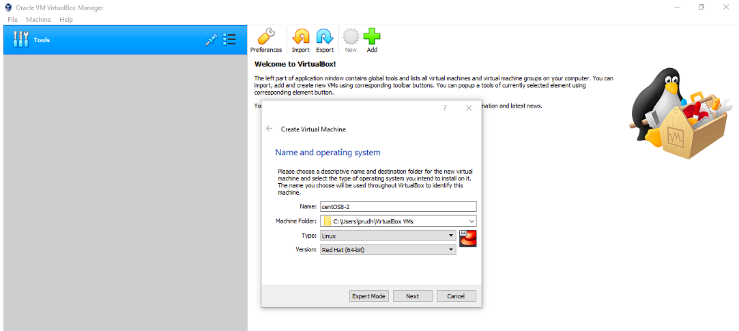
ORACLE VM

Slide 5
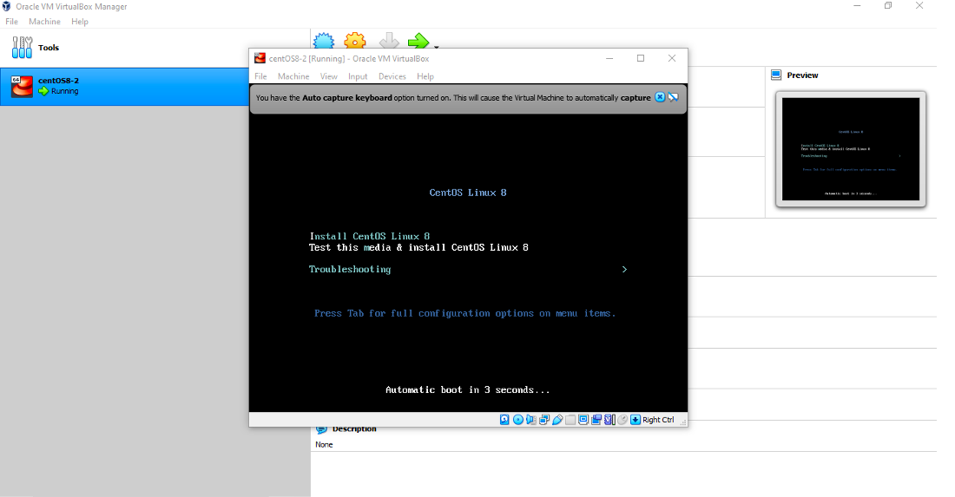
CENTOS LINUX 8

Slide 6

PROXY SERVER
Passing request and responses unmodified.
It can be placed on a local computer/ various points between user and destination servers on Internet.
Reverse Proxy and Forwarding Proxy.
Open Proxy – Forward the requests to and from anywhere on the internet.
Notes:
Reverse proxy – Internet facing proxy used within the front end
Forwarding proxy – forwards the traffic
An open proxy is a forwarding proxy that can be accessible by any internet user.

Slide 7
SQUID PROXY
Caching Proxy for Web Supporting HTTP, HTTPS and FTP.
Reduces Bandwidth and improves response time.
Can Route content requests to different servers.
Reduce server loads and improve delivery for clients.
Notes:
Reuses frequently requested web pages
SQUID dataflow optimizes the data flow between client and server by caching the content of web pages that are frequently used.

Slide 8
INSTALLATION
Refresh CentOS Software Repositories
sudo yum –y update
Install Squid Package on CentOS
yum –y install squid
Start Squid
systemctl start squid
Automatic start at boot
systemctl enable squid
Review status of service
systemctl status squid

Slide 9
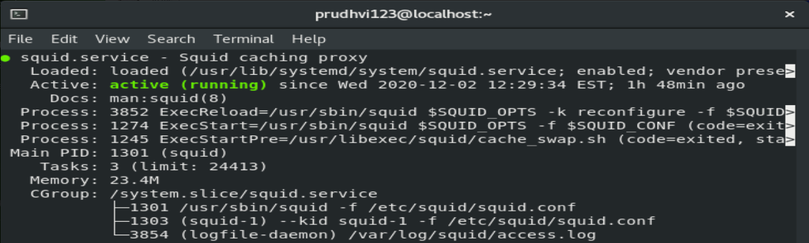
INSTALLATION

Slide 10
CONFIGURATION OF SQUID PROXY SERVER
Configuartion file is found at /etc/squid/squid.conf.
Open the file using command - sudo vi /etc/squid/squid.conf
Navigate to find the http_port option. Typically, this is set to listen on Port 3218. This port usually carries TCP traffic
http_acacess deny all – Block all HTTP traffic
http_access allow all – Unblock all HTTP traffic
sudo systemctl restart squid – Restart the Squid service

Slide 11
CONFIGURATION OF SQUID CLIENT
Configuration of Squid Client Server using Firefox under proxy settings and select Manual proxy configuartion –
Menu > Options > Network Settings > Settings
Create Access Control List (ACL)
Edit the /etc/squid/squid.conf - acl localnet src 192.166.0.10/30
Open a specific port - acl Safe_ports port 123 # Custom port
RestartSquid – systemctl restart squid

Slide 12
SECURITY
Blocking websites with Squid Proxy:
Create and edit a new text file /etc/squid/blocked.acl by entering
sudo vi /etc/squid/blocked.acl
Add the websites to be blocked, starting with a dot
.facebook.com, .twitter.com
The dot specifies to block all subsites of the main site.
Open the /etc/squid/squid.conf file again:
sudo vi /etc/squid/squid.conf Add the following lines just above your ACL list:
acl blocked_websites dstdomain “/etc/squid/blocked.acl” http_access deny blocked_websites

Slide 13

THANK YOU…!!!

